Slide 1
Quantum TensorFlow a framework for Quantum ML publish in 2020
22/5/2020

Slide 2



1. Architechture
A python framework for creating, editing, and invoking Noisy Intermediate Scale Quantum (NISQ) circuits.
Hybrid Quantum-Classical Machine Learning in TensorFlow

Slide 3
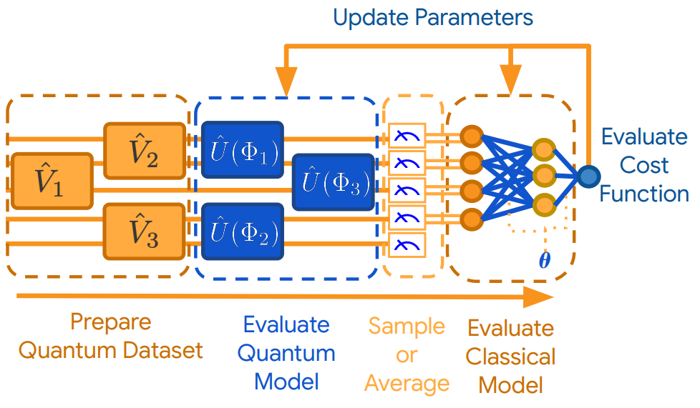
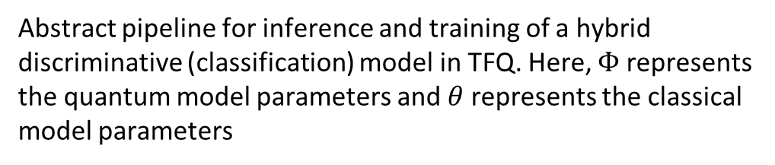
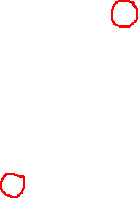
2. Pipeline
(1) Prepare Quantum Dataset: come from a given black-box source, like a chemical reaction
(2) Evaluate Quantum Model: conduct by Parameterized quantum models (Variation Quantum Eigenvalue solver, …). Extract information hidden in a quantum subspace or subsystem
(3) Sample or Average: convert quantum data to classical data throuth the distribution which come from the multiple time of measurement
(6) Evaluate Gradients & Update Parameters: After evaluating the cost function, the free parameters in the pipeline is updated in a direction expected to decrease the cost. This is most commonly performed via gradient descent. This allows both the quantum and classical models’ parameters to be optimized against quantum data via hybrid quantum-classical backpropagation.
Abstract pipeline for inference and training of a hybrid discriminative (classification) model in TFQ. Here, $Φ$ represents the quantum model parameters and $θ$ represents the classical model parameters

Slide 4
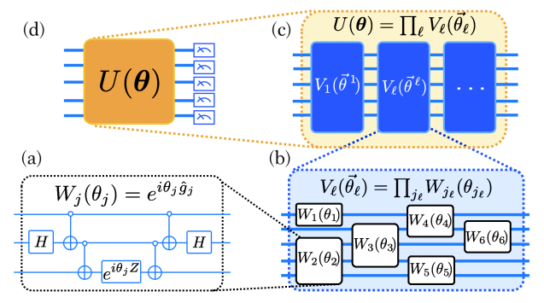
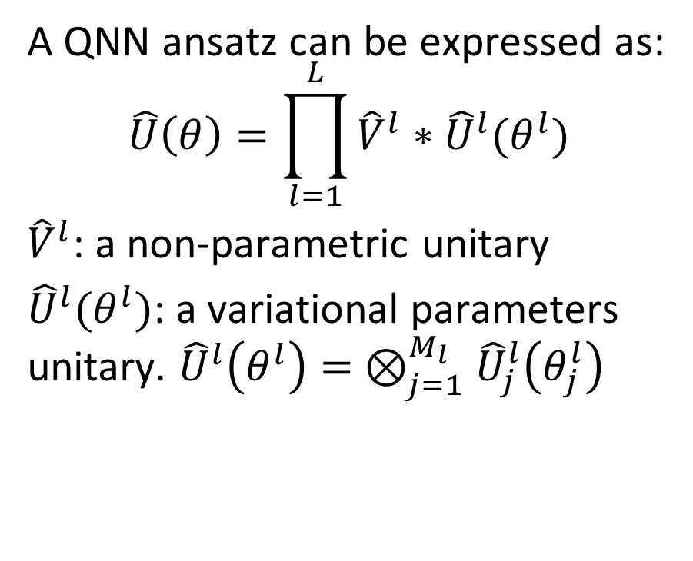
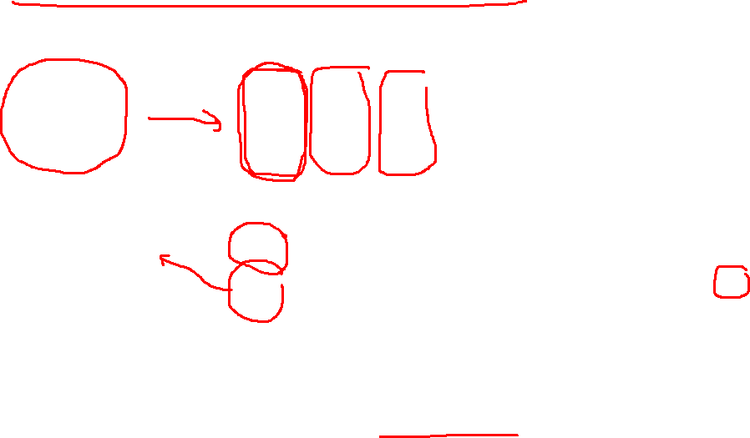
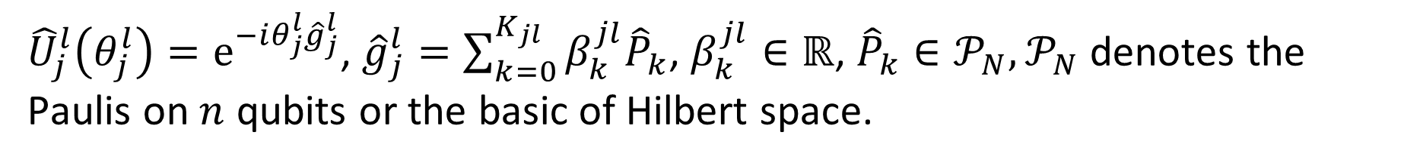
3. Quantum machine learning theory / QNN
A QNN ansatz can be expressed as:
$$\hat{U}\left(θ\right)=\prod_{l=1}^{L}{{\hat{V}}^{l}∗{\hat{U}}^{l}(θ^{l})}$$
${\hat{V}}^{l}$: a non-parametric unitary
${\hat{U}}^{l}(θ^{l})$: a variational parameters unitary. ${\hat{U}}^{l}\left(θ^{l}\right)= ⊗_{j=1}^{M_{l}}{\hat{U}}_{j}^{l}\left(θ_{j}^{l}\right)$
${\hat{U}}_{j}^{l}\left(θ_{j}^{l}\right)=e^{−iθ_{j}^{l}{\hat{g}}_{j}^{l}}$, ${\hat{g}}_{j}^{l}=\sum_{k=0}^{K_{jl}}{β_{k}^{jl}{\hat{P}}_{k}}$, $β_{k}^{jl}∈ℝ$, ${\hat{P}}_{k}∈𝒫_{N}, 𝒫_{N}$ denotes the Paulis on $n$ qubits or the basic of Hilbert space.

Slide 5
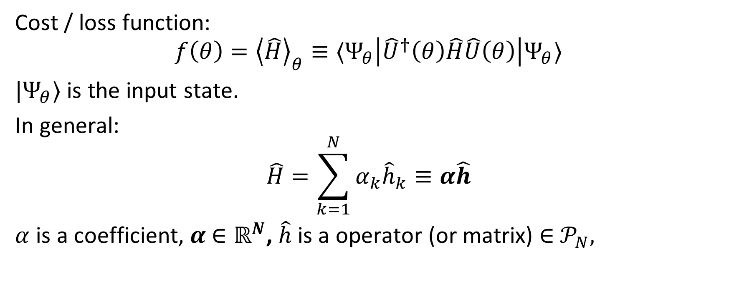
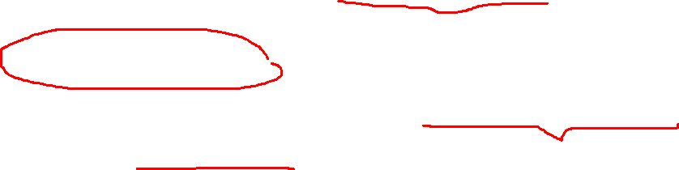
3. Sampling and Expectations
Cost / loss function:
$$f\left(θ\right)={\left\langle \hat{H}\right\rangle }_{θ}≡⟨Ψ_{θ}\left|{\hat{U}}^{†}\left(θ\right)\hat{H}\hat{U}\left(θ\right)\right|Ψ_{θ}⟩$$
$|Ψ_{θ}⟩$ is the input state.
In general:
$$\hat{H}=\sum_{k=1}^{N}{α_{k}{\hat{h}}_{k}≡α\hat{h}}$$
$α$ is a coefficient, $α$ $∈ℝ^{N}$, $\hat{h}$ is a operator (or matrix) $∈$ $𝒫_{N},$

Slide 6
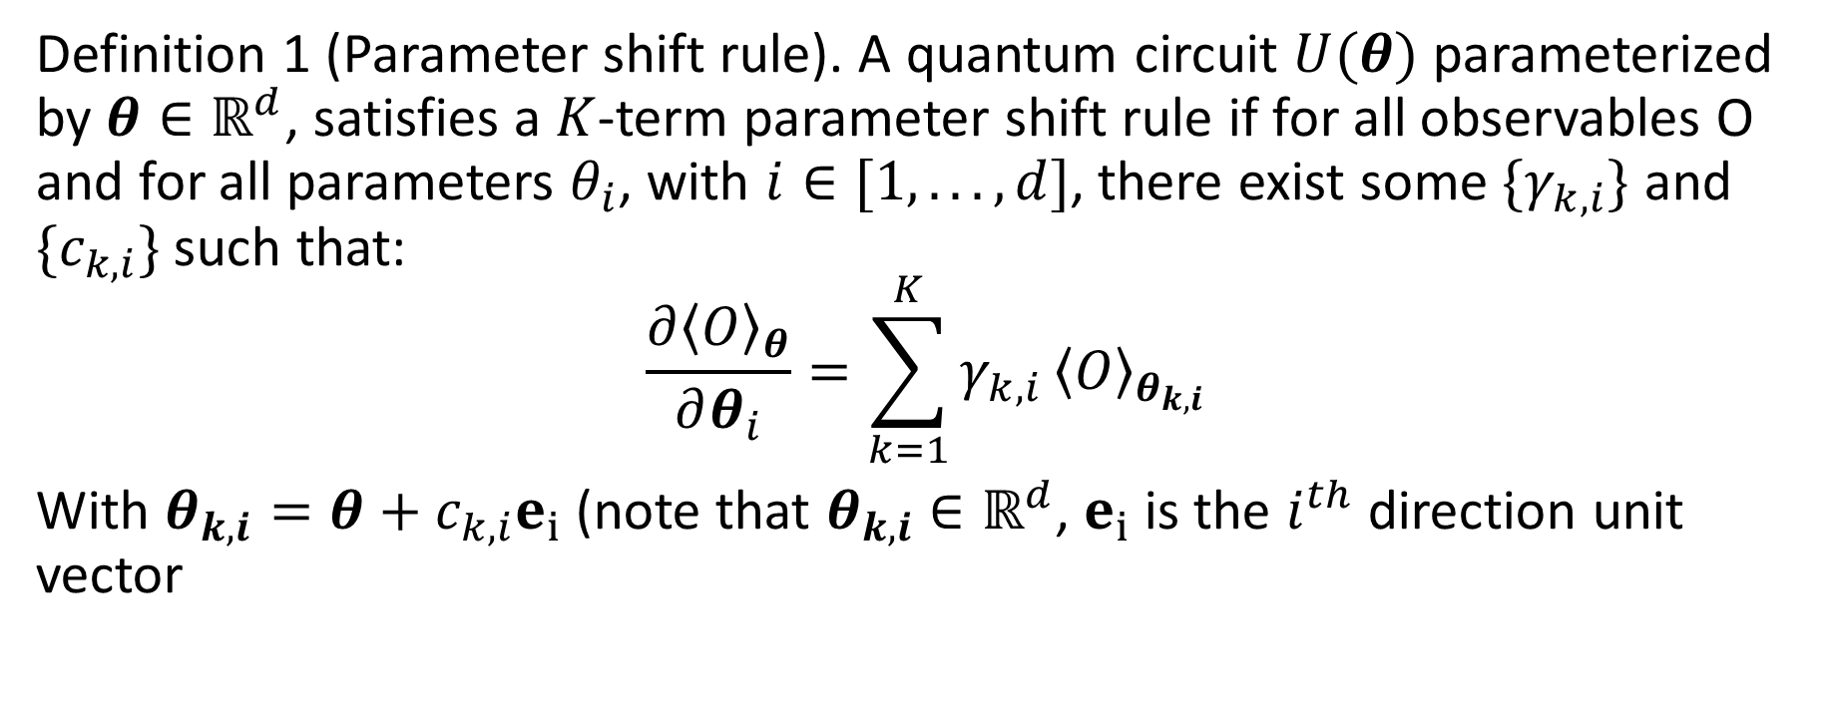
Definition 1 (Parameter shift rule). A quantum circuit $U(θ)$ parameterized by $θ∈ℝ^{d}$, satisfies a $K$-term parameter shift rule if for all observables O and for all parameters $θ_{i}$, with $i∈[1, . . . , d]$, there exist some $\{γ_{k,i}\}$ and $\{c_{k,i}\}$ such that:
$$\frac{∂{\left\langle O\right\rangle }_{θ}}{∂θ_{i}}=\sum_{k=1}^{K}{γ_{k,i}}{\left\langle O\right\rangle }_{θ_{k,i}}$$
With $θ_{k,i}=θ+c_{k,i}e_{i}$ (note that $θ_{k,i}$ $∈ℝ^{d}$, $e_{i}$ is the $i^{th}$ direction unit vector

Slide 7
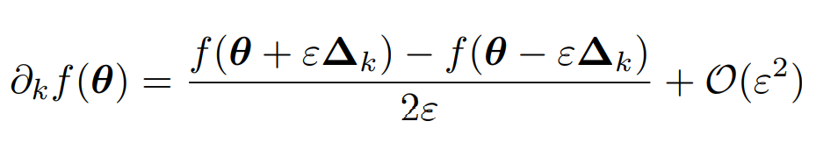

3. Gradient of QNN (Central finite - difference method)
$ε$: learning rate
$𝒪\left(ε^{2}\right):$ precision
${\left(∆_{k}\right)}_{j}=δ_{j,k}$ is the delta Kronecker (0 or 1)
Use $2M$ queries with $M$ is the number of params

Slide 8
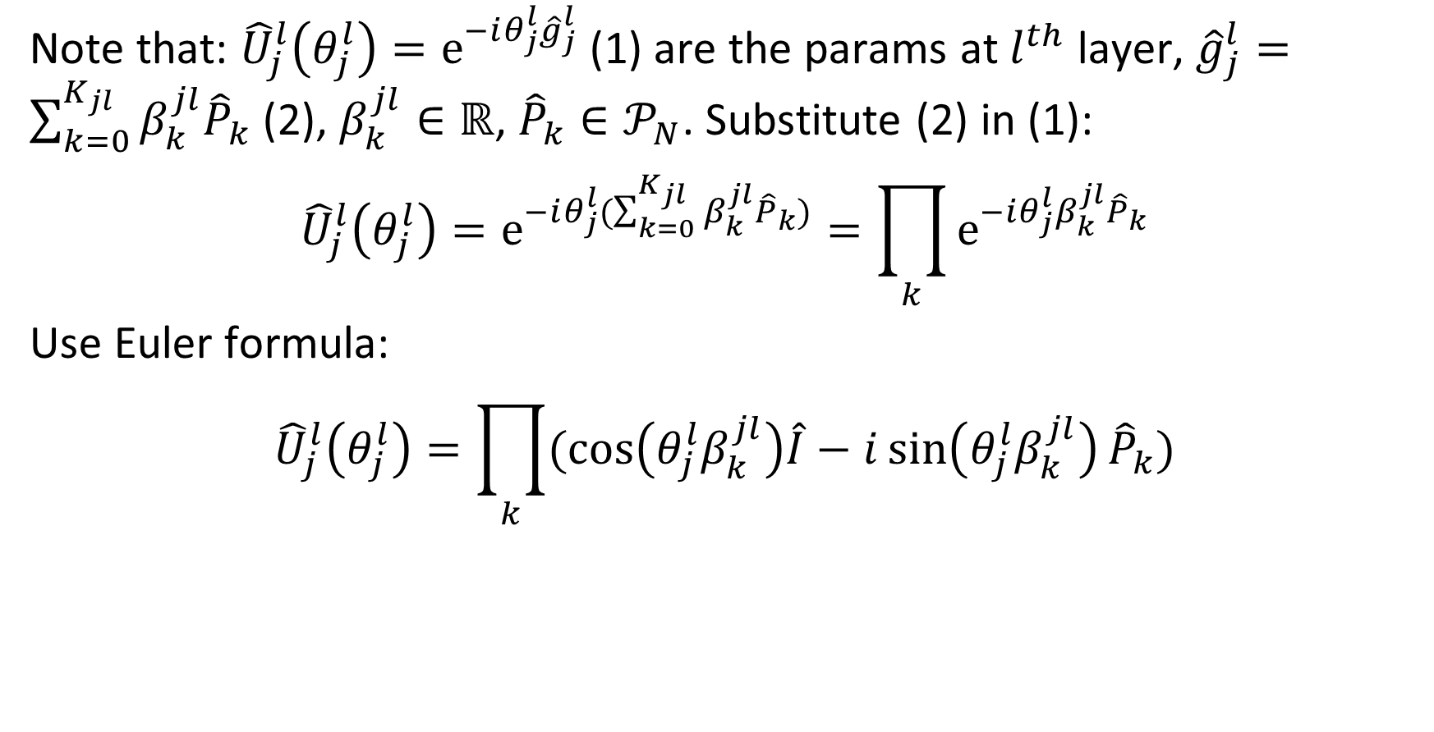
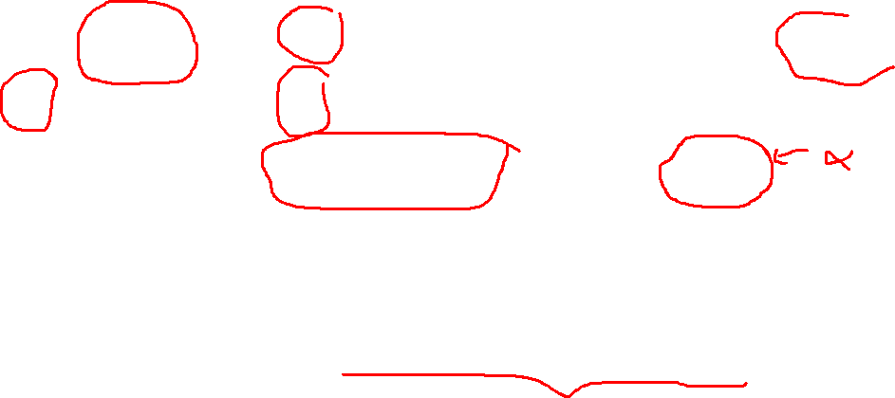
3. Gradient of QNN (Parameter shift methods)
Note that: ${\hat{U}}_{j}^{l}\left(θ_{j}^{l}\right)=e^{−iθ_{j}^{l}{\hat{g}}_{j}^{l}}$ (1) are the params at $l^{th}$ layer, ${\hat{g}}_{j}^{l}=\sum_{k=0}^{K_{jl}}{β_{k}^{jl}{\hat{P}}_{k}}$ (2), $β_{k}^{jl}∈ℝ$, ${\hat{P}}_{k}∈𝒫_{N}$. Substitute (2) in (1):
$${\hat{U}}_{j}^{l}\left(θ_{j}^{l}\right)=e^{−iθ_{j}^{l}(\sum_{k=0}^{K_{jl}}{β_{k}^{jl}{\hat{P}}_{k}})}=\prod_{k}{e^{−iθ_{j}^{l}β_{k}^{jl}{\hat{P}}_{k}}}$$
Use Euler formula:
$${\hat{U}}_{j}^{l}\left(θ_{j}^{l}\right)=\prod_{k}{(cos\left(θ_{j}^{l}β_{k}^{jl}\right)\hat{I}−i\sin\left(θ_{j}^{l}β_{k}^{jl}\right){\hat{P}}_{k})}$$

Slide 9
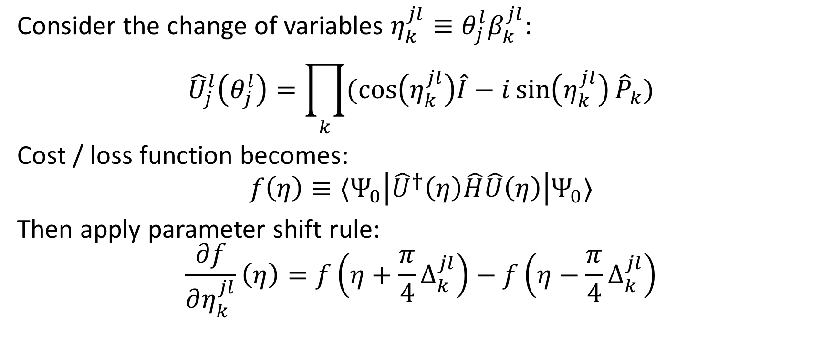
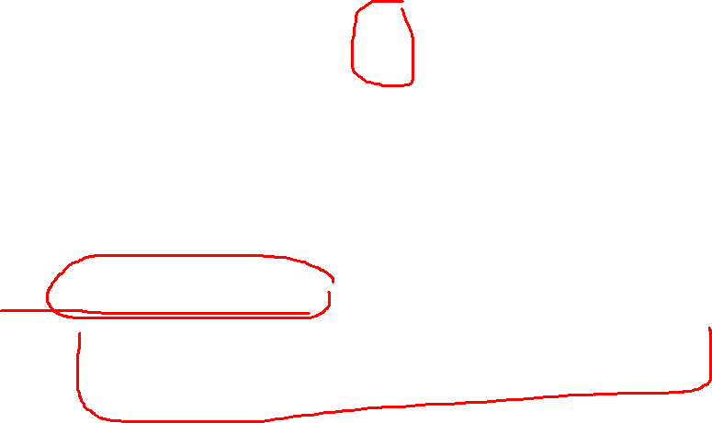
3. Gradient of QNN (Parameter shift methods)
Consider the change of variables $η_{k}^{jl}≡θ_{j}^{l}β_{k}^{jl}$:
$${\hat{U}}_{j}^{l}\left(θ_{j}^{l}\right)=\prod_{k}{(cos\left(η_{k}^{jl}\right)\hat{I}−i\sin\left(η_{k}^{jl}\right){\hat{P}}_{k})}$$
Cost / loss function becomes:
$$f\left(η\right)≡⟨Ψ_{0}\left|{\hat{U}}^{†}\left(η\right)\hat{H}\hat{U}\left(η\right)\right|Ψ_{0}⟩$$
Then apply parameter shift rule:
$$\frac{∂f}{∂η_{k}^{jl}}\left(η\right)=f\left(η+\frac{π}{4}∆_{k}^{jl}\right)−f\left(η−\frac{π}{4}∆_{k}^{jl}\right)$$

Slide 10
3. Stochastic Parameter Shift Gradient Estimation
…

Slide 11
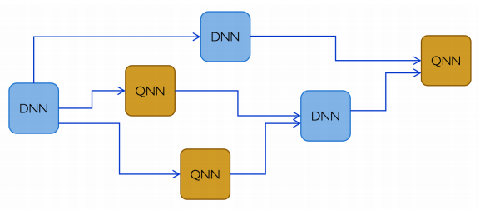
4. Hybrid Quantum-Classical Computational Graphs

